Slide 1
Introduction HTML and HTML Elements and Attributes
Session 2
(slot 2-3)

Slide 2
Contents
Introduction to HTML
Explain the basic and formatting elements.
Explain the HTML Attributes
Explain the image element.
Explain hyperlinks.

Slide 3
HTML Introduction
HTML stands for Hyper Text Markup Language
A markup language is a set of markup tags
HTML documents are described by HTML tags
Each HTML tag describes different document content

Slide 4
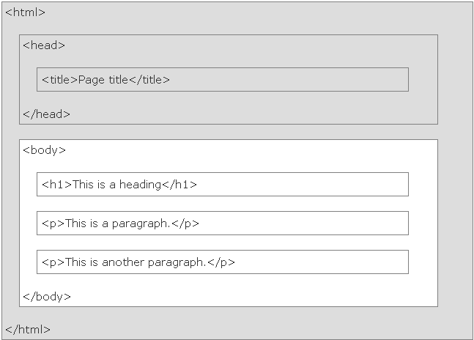
HTML Page Structure
<!DOCTYPE html>
declaration helps the browser to display a web page correctly
provides information about the document
<meta charset="UTF-8">
Only the <body> area (the white area) is displayed by the browser.

Slide 5
HTML Elements
HTML tags are keywords (tag names) surrounded by angle brackets:
<tagname>content</tagname>
ex: <h1>this is heading 1</h1>
HTML elements with no content are called empty elements.
ex: <br />
Nest HTML elements can be nested (elements can contain elements)
ex: <head><title>welcome</title></head>

Slide 6
Basic elements
Providing a flow to the contents.
Making the web page comprehensible.
P
BR
HR
H1 – H6
PRE

Slide 7
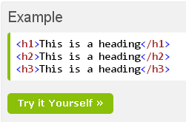
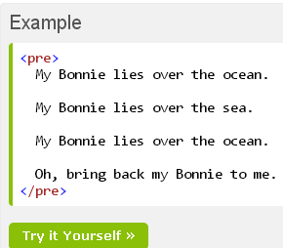
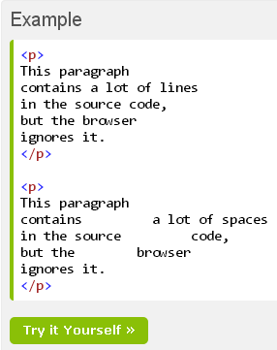
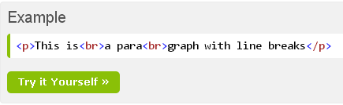
Basic elements

Slide 8
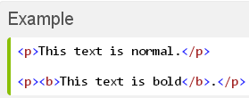
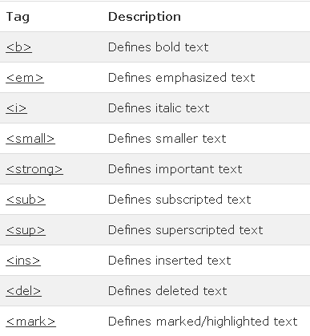

HTML text formatting elements

Slide 9
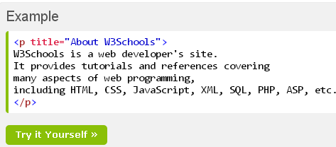
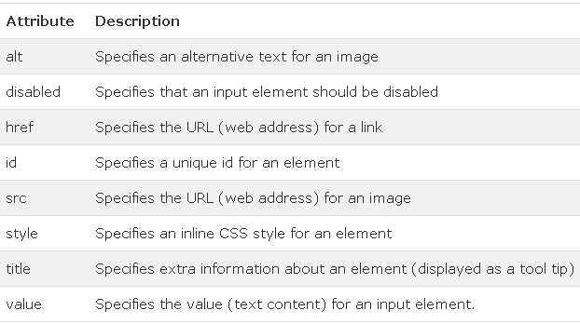
HTML Attributes
HTML elements can have attributes
Attributes provide additional information about an element
Attributes are always specified in the start tag
Attributes come in name/value pairs like: name="value"

Slide 10
Character entity
Symbol name | Entity name | Entity number
Ampersand (&) | &amp; | &#38;
Greater than (>) | &gt; | &#62
Less than (<) | &lt; | &#60
non-breaking space | &nbsp; | &#160
Quotation mark (“ “) | &quot; | &#34

Slide 11
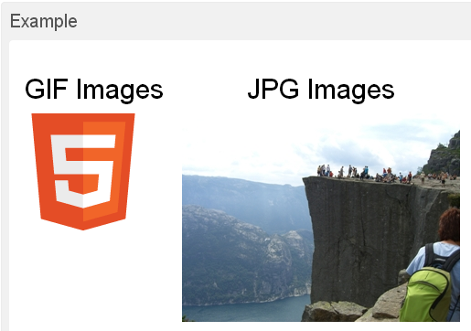
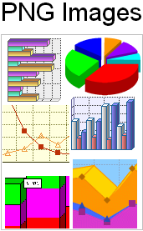
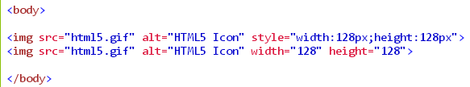
Image Element
SRC
WIDTH
HEIGHT
ALT
ALIGN
USEMAP

Slide 12
Image maps
There are different areas that act as links in an image.
Map element
AREA element

Slide 13
Image maps
<BODY>
<H2>Search engines</H2>
<MAP name="searchmap">
<AREA href="http://www.google.com" alt="Google" shape="rect” coords="0,0,170,35"/>
<AREA href="http://www.ask.com" alt="Ask" shape="rect” coords="0,28,170,70"/>
</MAP>
<img src="SearchEngines.JPG" alt="Search Engines" width="286" height="99" usemap="#searchmap"/>
</BODY>

Slide 14
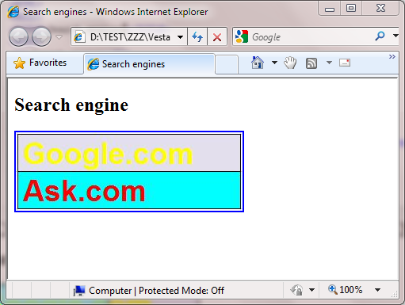

Image maps

Slide 15
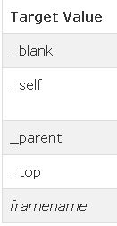

Hyperlinks
A hyperlink is a text or an image you can click on, and jump to another document.
HREF
ID
TARGET
<a href=“url” target=“…”>link text </a>

Slide 16
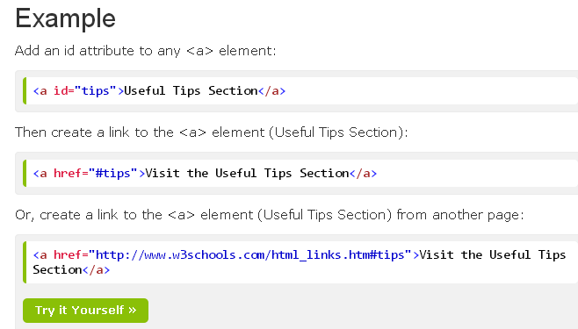
Hyperlinks

Slide 17


Other Elements
Comment
Video(HTML5)
Object

Slide 18
Other Elements
Meta

Slide 19
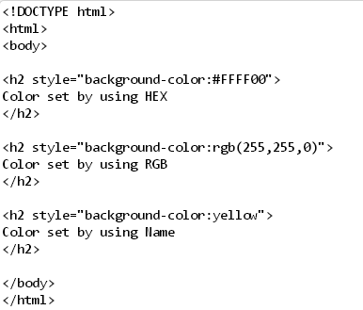
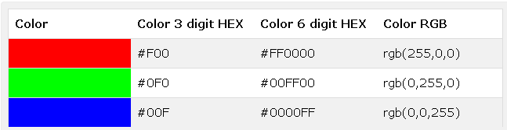
Color Values

Slide 20
Summary
Basic text elements providing a flow to the contents.
W3C defined 16 color name for HTML.
Phrase elements display code in different font emphasizing with a different look.
There are different areas that act as links in an image.
hyperlink allows jump to another document

Slide 21
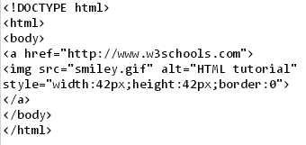
Exercise 1

Slide 22
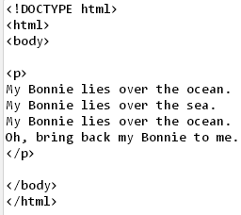
Exercise 2

Slide 23
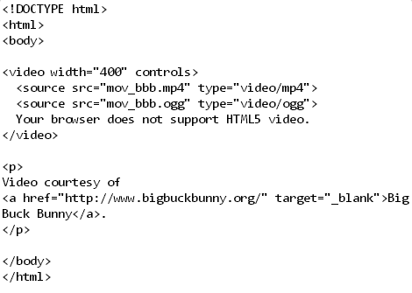
Exercise 3

